Slide 1
Dynamic Programming
Optimal Binary Search Trees

Slide 2
Binary Search Tree- BST
Binary Search Trees
consider a particular kind of a binary tree called a Binary Search Tree (BST).
The basic idea behind this data structure is to have such a storing repository that provides the efficient way of data sorting, searching and retrieving.

Slide 3
More tree terminology
The depth of a node is the number of edges from the root to the node.
The height of a node is the number of edges from the node to the deepest leaf.
The height of a tree is a height of the root.
A full binary tree is a binary tree in which each node has exactly zero or two children.
A complete binary tree is a binary tree, which is completely filled, with the possible exception of the bottom level, which is filled from left to right.

Slide 4
Binary Search Tree
A BST is a binary tree where nodes are ordered in the following way:
each node contains one key (data)
the keys in the left sub-tree are less then the key in its parent node, in short L < P;
the keys in the right sub-tree are greater the key in its parent node, in short P < R;
duplicate keys are not allowed.
Depth - 0
Depth - 1
Depth - 2

Slide 5
Optimal BST
Given numbers w₁,w₂,w₃, ……..w_{n} and probabilities p₁,p₂,p₃,….p_{n} of their occurrences
Arrange these numbers in BST that minimizes access time ?
Note: In BST the number of comparisons needed to access an element at depth d is (d+1)
The cost of finding out a number, i :
C = p_{i} * (d +1)

Slide 6

Optimal BST problem
If w_{i} is placed at depth d_{i}, then we want to minimize the cost
$$\sum_{i=1}^{n}{pi(d+1)}$$

Slide 7
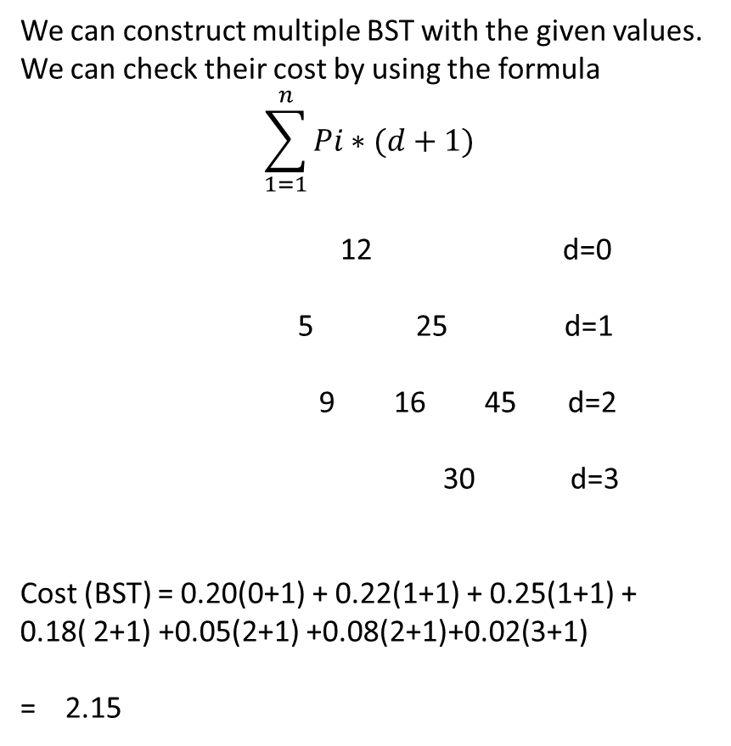
Example
Numbers Wi | Probability Pi
5 | 0.22
9 | 0.18
12 | 0.20
16 | 0.05
25 | 0.25
30 | 0.02
45 | 0.08

Slide 8
Optimal BST problem
How to find the minimum cost (optimum) solution for all these possible results?
Dynamic Programming

Slide 9
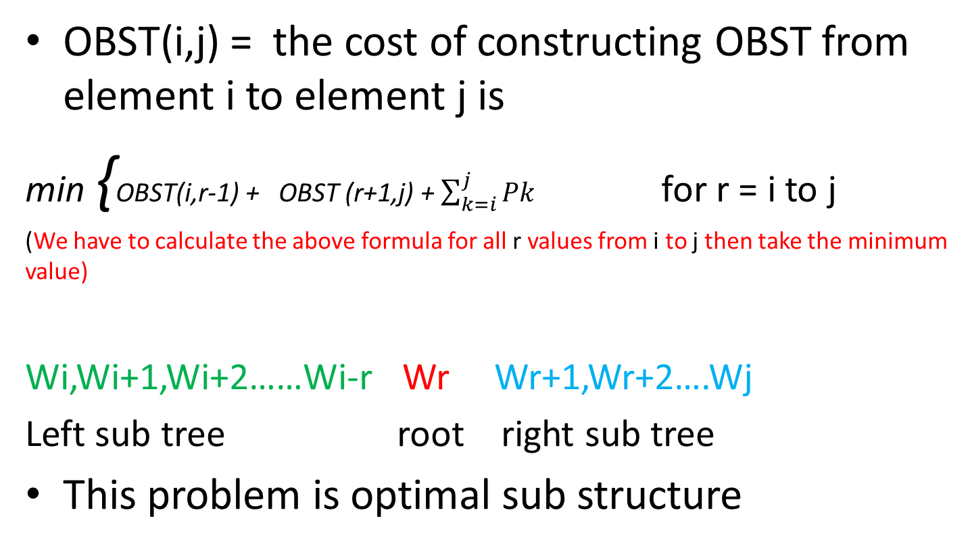
OBST – dynamic Programming approach
OBST(i,j) = the cost of constructing OBST from element i to element j is
min {OBST(i,r-1) + OBST (r+1,j) + $\sum_{k=i}^{j}{Pk}$ for r = i to j
(We have to calculate the above formula for all r values from i to j then take the minimum value)
Wi,Wi+1,Wi+2……Wi-r Wr Wr+1,Wr+2….Wj
Left sub tree root right sub tree
This problem is optimal sub structure

Slide 10
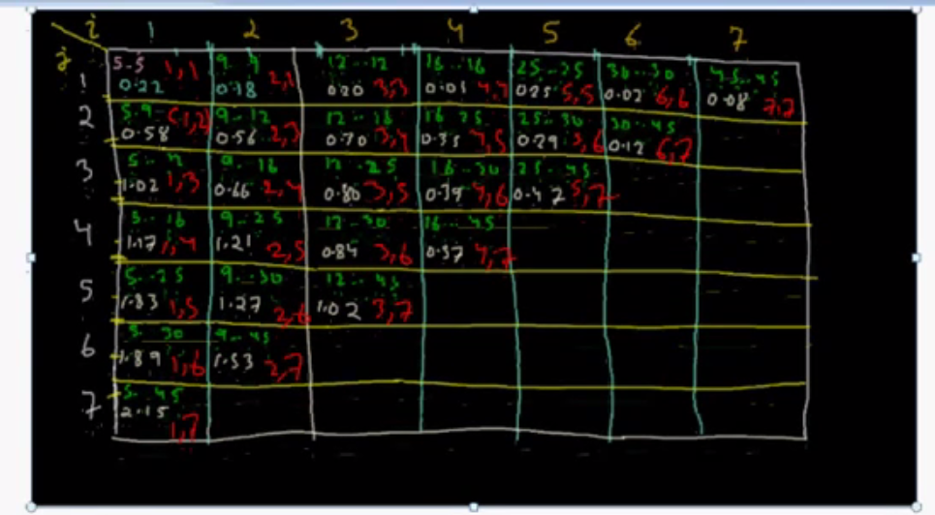
Traveller Matrix

